Slide 1
Managing Supply Chains: Concepts, Tools, Applications Chapter 5: Coordination
These powerpoints are a companion to the book: Managing Supply Chains: Concepts, Tools and Applications by Ananth. V . Iyer, Hercher Publishing Inc., ISBN 978-1-939297-01-3

Slide 2
Outline
Coordination – definition and examples
A model of coordination and impact
Take-or-pay contracts
Capacity Reservation contracts
Advance Order Quantity
Summary

Slide 3
Coordination - definitions ([80])
“bring together the different elements (of a complex activity or organization) into a harmonious or efficient relationship.”
“negotiate with others in order to work effectively”
“match or harmonize” the needs of multiple constituents.
Coordination is a key when parts of a supply chain are controlled or owned by different entities

Slide 4
Coordination – US Coast Guard (Section 5.1)
Aircraft Repair and Service Center
Central repair facility for all 26 airstations
Engineering Division (ACMS) – tracks parts by serial number, monitors part age, repair or overhaul
Inventory Division (AMMIS) – maintains inventory of repaired parts, trigger part repair

Slide 5
Coordination – US Coast Guard
Use part age to link to demand over lead time
Intuition – if demands not observed, then parts on aircraft are ageing, thus increasing the probability of impending demand
Each period, identify a count of parts whose age exceeds an age threshold
Empirically estimate the correlation between part age threshold related counts and observed demand (see next page)

Slide 6
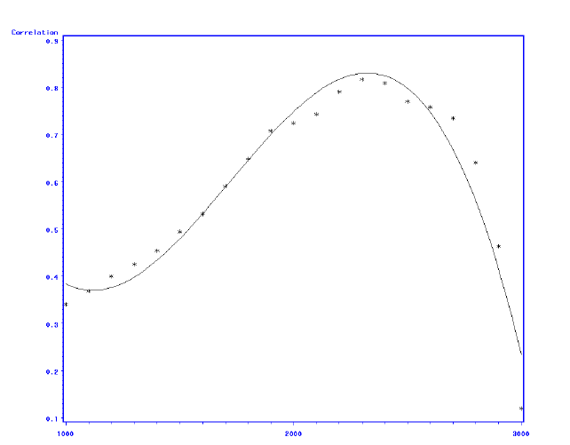
Correlation between demand and part age signals for different age thresholds
Correlation
Optimal Age Threshold
Age Threshold

Slide 7
Coordination – US Coast Guard
Set the optimal age threshold as shown in the earlier page
Adjust the repaired product inventory synchronized with the projected demand
Thus the time that repaired parts remain in the system before use decreases
This reduces the cost of part repair while matching supply and demand – achieving coordination between the engineering and inventory systems

Slide 8
Coordination - Revenue Sharing Agreements
Lucas Aerospace and Rolls Royce – Lucas invests in fuel control systems and gets revenue from use of Rolls Royce engines
Movie studios and Blockbuster Rental– provide videos for $8 and a share of customer rental income
Wind Turbine installer and Lorian County – land leases provided by county for 20% of energy revenue sharing

Slide 9
Coordination
By aligning incentives, decisions made reflect joint objectives to maximize supply chain profit
The agreement enables risk sharing thus optimal responses to uncertainty
Coordination incents manufacturers to make products more durable, retailers to carry the optimal level of inventory etc
Models discussed later

Slide 10
Coordination – A Model
Single Manufacturer – cost “c_{k}” to reserve capacity, cost per unit “c” to manufacture
Wholesale price “w”
Retail price “r”
Demand is uncertain, mean μ, standard deviation σ
Manufacturer chooses capacity “K”
Retailer orders “L” periods later, after observing demand
Orders satisfied up to capacity “K”

Slide 11
Supply Chain Optimal Decisions
K_{c} – optimal capacity to maximize supply chain profit
F(K_{c}) = (r-c-c_{k})/(r-c)
(Set Cs = r-c-c_{k} and Ce = c_{k} and Cs/(Cs+Ce) is the optimal critical fractile)

Slide 12
Manufacturer Optimal Capacity
If the manufacturer chooses capacity
F(K) = (w-c-c_{k})/(w-c)

Slide 13
Example – Supply Chain Decisions
See Table 5.1 for demands
r=4,w=2,c=0.6,c_{k}=0.5
F(Kc) = (4-0.6-0.5)/(4-0.6) = 0.852
K_{c} = 20 (from Table 5.1)
Associated expected profit = 40.32 (Table 5.2)

Slide 14
Manufacturer Chooses Capacity – Supply Chain Impact
Wholesale price contract
Manufacturer chooses capacity independently to maximize his profit
F(K_{w}) = (2-0.6-0.5)/(2-0.6) = 0.643
K_{w} = 17
Manufacturer expected profit = 11.1
Retailer expected profit = 28
Associated Supply Chain Profit = 39.1 (< 40.32)
Why ?
Double marginalization – each entity looks out for their portion of the profit thus makes suboptimal decisions for the supply chain

Slide 15
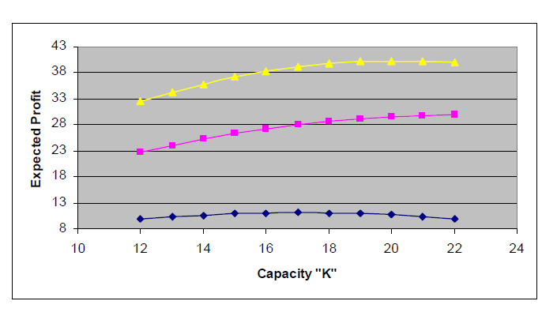
Expected Profits with a wholesale price agreement
K=20 maximizes supply chain profits
K=17 maximizes manufacturer profits
The wholesale price agreement does not coordinate the supply chain

Slide 16
Take or pay contract
Retailer pays “w” per unit taken and “τ” per unit of leftover capacity
Thus the manufacturer critical fractile is
(w-c-c_{k})/(w-c-τ)
Set it equal to (r-c-c_{k})/(r-c) to get
τ=(r-w)c_{k}/(r-c-c_{k})
So if w=1.95, calculate τ=0.35

Slide 17
Take or pay contract
r=4,w=1.95,c=0.6,c_{k}=0.5, τ=0.35
Manufacturer service level
= (1.95-0.6-0.5)/(1.95-0.6-0.35)= 0.85
Manufacturer chosen K = 20
Manufacturer expected profit = 11.82
Retailer expected profit = 28.5
Supply Chain profit = 40.32
Coordinated Supply Chain with a coordinating take-or-pay agreement – generates a win-win agreement

Slide 18
Pie Chart View
Uncoordinated Supply Chain
Wholesale Price Agreement
Manufacturer chooses Capacity
Supply Chain Profit = 39.1
Coordinated Supply Chain
Take or pay contract for capacity
Manufacturer chooses Capacity
Supply Chain Profit = 40.32

Slide 19
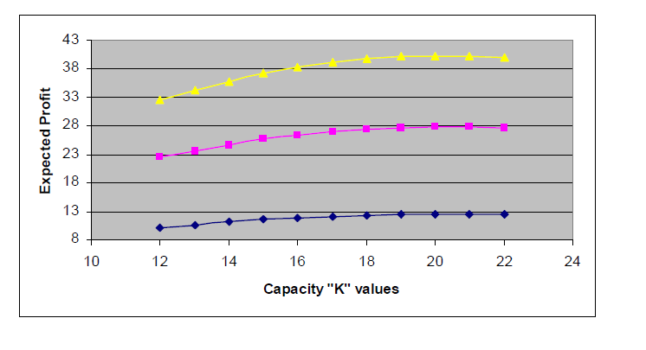
Expected Profits and Coordination – take-or-pay contract
Note that the supply chain and manufacturer profits are now maximized
at the same capacity level of K=20

Slide 20
Capacity Reservation Contract (Section 5.9)
The retailer pays a cost “p” per unit to reserve capacity and “w1” per unit to use capacity
Note that this contract is the same as setting
p = τ and setting w1 = w-τ = 1.95-0.35 = 1.60 in the take-or-pay contract
Thus the capacity reservation contract with appropriate p and w1 also coordinates the supply chain

Slide 21
Advance Order Quantity
Advance Order Quantities are another coordinating agreement
The retailer commits to an order ahead of demand by paying w_{a} (<= w) per unit
The retailer orders later (after demand is revealed) and pays w per unit
Even if w_{a} is chosen to get the retailer to order “K”, the supply chain is not coordinated
Advance order quantities are not guaranteed to coordinate the supply chain

Slide 22
Summary
In the absence of coordinating agreements, the supply chain profit is not maximized
Coordinating agreements enable independent decisions by participants in the supply chain while attaining the supply chain maximum profit
These coordinating agreements can be structured to generate win-win outcomes
Coordination agreements offer a tool to enable both supply chain profit increases as well as win-win outcomes across supply chain participants

